Slide 1
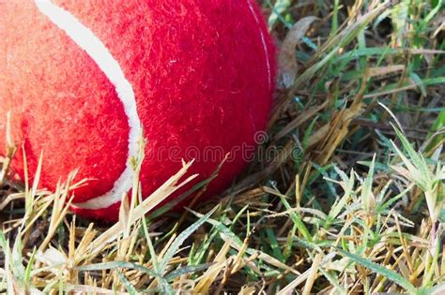
Observations and Inferences – Page 1
In the following passage, underline or highlight all the key-words and information. Then, answer the questions below.
Observations and inferences are two key concepts in scientific inquiry and critical thinking. When doing experiments, we use these to learn more about the world around us.
Observations are things that we can see, hear, touch, taste, or smell using our five senses. They are facts that we can prove, and they are not influenced by what we believe or think. For example, if we see a red ball on the ground, that is an observation.
Inferences are things that we figure out based on what we observe and what we know. They are ideas that we come up with in our heads. For example, if we see a person running down the street, we might infer that they are in a hurry or trying to catch a bus.
In summary, observations are things that we can sense and are true, while inferences are things that we figure out based on what we observe and what we know. Both are important to help us understand the world around us, but we need to be careful to make sure our inferences are based on accurate observations.
What is an observation?
______________________________________________________________________
What is an example of an observation? ______________________________________________________________________
What is an inference?
______________________________________________________________________
What is an example of an inference?
______________________________________________________________________

Slide 2
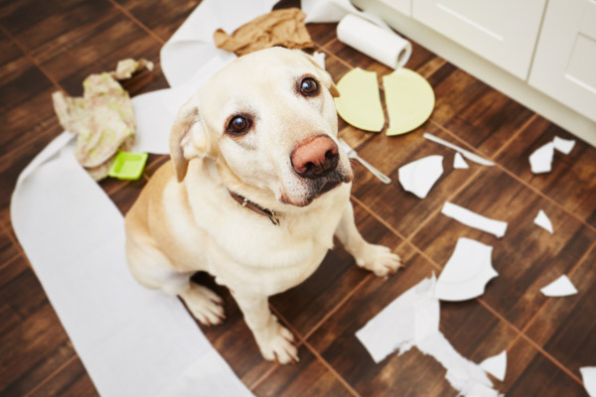
Observations and Inferences – Page 2
For each of the following, circle if they are an observation or an inference:
The sky is blue. Observation Inference
The boy is happy. Observation Inference
The flower is yellow. Observation Inference
The girl is wearing a green shirt. Observation Inference
The pizza smells delicious. Observation Inference
The dog is sleeping. Observation Inference
The water is cold. Observation Inference
The boy is tired after playing outside all day. Observation Inference
The sun will come up tomorrow. Observation Inference
The cat is hiding under the bed. Observation Inference
Identify 3 observations and 1 inference in the following picture. Remember, observations are what you can see is definitely true, and inferences are what you think has happened.
Observations:
Inference:
What are some examples of inferences that we make every day? For example, we know from the weather report that it might be sunny or rainy.
__________________________________________________________________ __________________________________________________________________

